Slide 1
Unix IPC
Unix has three major IPC constructs to facilitate interaction between processes:
Message Queues (this PowerPoint document)
  permit exchange of data between processes
Semaphores
  can be used to implement critical-section problems; allocation of resources
Shared Memory
  an area of memory accessible by multiple processes.

Slide 2

IPC System Calls
Functionality | Message Queue | Semaphore | Shared
Allocate IPC | msgget | semget | shmget
Access IPC | msgsnd msgrcv | semop | shmat shmdt
IPC Control | msgctl | semctl | shmctl

Slide 3
Message Queues
Creating a Message Queue
Message Queue Control
Message Queue Operations
IPC Call
Client-Server Example

Slide 4
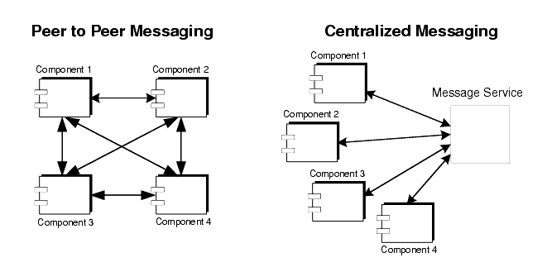
Messaging Methods

Slide 5
Message Queues
One process establishes a message queue that others may access. Often a server will establish a message queue that multiple clients can access
Features of Message Queues
  A process generating a message may specify its type when it places the message in a message queue.
  Another process accessing the message queue can use the message type to selectively read only messages of specific type(s) in a first-in-first-out manner.
  Message queues provide a user with a means of multiplexing data from one or more producer(s) to one or more consumer(s).

Slide 6
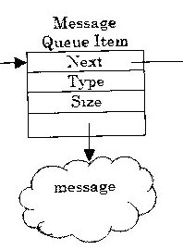
Attributes of Message Queues
A conceptual view of a message queue, from Interprocess Communications in Unix:
  The attributes of each element on the queue:
- long integer type;
- size of the data portion of the message (can be zero);
* A message queue element then has one more field:
- data (if the length is greater than zero)
* Message Structure

Slide 7
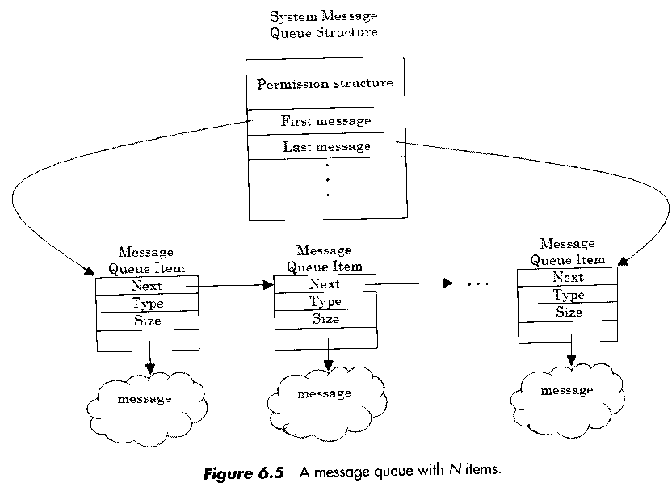
Message Queue Structure

Slide 8
msqid_ds Structure
struct msqid_ds {
struct ipc_perm msg_perm; /*operation permission struct */
struct msg *msg_first; /* pointer to first message on q*/
struct msg *msg_last; /* point to last message on q */
ulong msg_cbytes; /* current # bytes on q */
ulong msg_qnum; /* # of message on q */
ulong msg_qbytes; /* max # of bytes on q */
pid_t msg_lspid; /* pid of last msgsnd */
pid_t msg_lrpid; /* pid of last msgrcv */
time_t msg_stime; /* last msgsnd time */
............................
}; /* total 17 members */

Slide 9
ipc_perm Structure
* struct ipc_perm {
uid_t uid; /*owner’s user ID */
gid_t gid; /* owner’s group ID */
uid_t cuid; /* creator’s user ID */
gid_t cgid; /* creator’s group ID */
mode_t mode; /* access modes */
ulong seg; /* slot usage sequence number */
key_t key; /* key */
long pad[4]; /* reserve area */
};
* Struct msqid_ds {
struct ipc_perm msg_perm; .....};

Slide 10
msg structure
struct msg {
struct msg *msg_next; /* pointer to next message on q */
long msg_type; /* message type */
ushort msg_ts; /* message text size */
short msg_spot; /* message text map address */
};

Slide 11
msgget System Call
Create a message queue.
Includes: <sys/types.h> <sys/ipc.h> <sys/msg.h>
Command: int msgget(key_t key, int msgflg);
  Returns: Success: message queue identifier ;
  Failure: -1;
  Arguments:
    key: to be specified directly by the user or generated using ftok. We will use a function getuid() to generate unique, consistent message queues for each person
    msgflg: IPC_CREAT, IPC_EXCL or permission value.
Example of generating a message queue: Qcreate.cpp

Slide 12
msgsnd System Call (Message Queue Operation)
Function: to place (send) message in the message queue.
Include: <sys/types.h> <sys/ipc.h> <sys/msg.h>
Summary:
  int msgsnd ( int msqid, const void *msgp, size_t msgsz, int msgflg)
  Returns: Success: 0; Failure: -1; Sets errno: Yes
  Arguments
    int msgid: valid message queue identifier
    const void *msgp: address of the message to be sent
    size_t msgsz: the size of the message to be sent.
    int msgflg: Two possible values:
      0: Block, if the message queue is full
      IPC_NOWAIT : don’t wait if message queue is full

Slide 13
msgrcv System Call ( Message Queue Operation)
Function: to retrieve message from the message queue.
  Include <sys/types.h> <sys/ipc.h> <sys/msg.h>
  int msgrcv ( int msqid, void *msgp,
  size_t msgsz, long msgtyp, int msgflg);
    Return: Success: number of bytes actually received;
    Failure: -1; Sets errno: Yes
Arguments:
  int msqid: the message queue identifier.
  void *msgp: a point to received message location (structure).
  size_t msgsz: the maximum size of the message in bytes.
  long msgtype: the type of the message to be retrieved.
  int msgflg: to indicate what action should be taken.
    0: error if size of message exceeds msgsz
    MSG_NOERROR: if size of message exceeds msgsz, accept msgsz bytes
    IPC_NOWAIT: return –1 with errno set to ENOMSG

Slide 14
Type of Message (msgrcv System Call)
int msgrcv ( int msqid, void *msgp, size_t msgsz,
long msgtyp, int msgflg);
long msgtype: the type of the message to be retrieved.
  Actions for msgrcv as indicated by msgtyp value
msgtyp value | action
0 | return first (oldest) message on queue
> 0 | return first message with type equal to msgtyp
< 0 | return the first message with lowest type less than or equal to msgtyp

Slide 15
msgctl System Call - Message Queue Control
Function
Ownership and access permissions, established when the message queue was created, can be examined and modified using the msgctl system call.
Include
< sys/types.h> <sys/ipc.h> < sys/msg.h>
Command:
int msgctl ( int msqid, int cmd, struct msqid_ds * buf);
Return
Success: 0; Failure: -1; Sets errno: Yes

Slide 16
Arguments of msgctl System Call
int msqid
  Message queue identifier ( generated by msgget call)
int cmd
  Indicates one of the following actions:
    IPC_STAT: return the current value for each member of the
    msgid_ds data structure (contains the permission structure).
    IPC_SET: the user can modify a limited number of msgid_ds structure member value, such as msg_perm.uid; msg_perm.gid; msg_perm.mode; and msg_qbytes.
    IPC_RMID: removes all associated message queue structure.
struct msqid_ds *buf : pointer to a msgid_ds struct

Slide 17
Remove a Message Queue in a Program
Command:
msgctl (msqid, IPC_RMID, (struct msqid_ds *) 0);
To remove the message queue with key msqid.
You must be the owner

Slide 18
ipcs & ipcrm Command
% ipcs – display ipc structures active in system
T ID KEY MODE OWNER GROUP QBYTES
Message Queues:
q 50 0X67028a01 -Rrw-rw---- gray other 4096
Shared Memory facility not in system
T ID KEY MODE OWNER GROUP NSEMS
Semaphores:
s 0 0X000187cf --ra-ra-ra- root root 2
s 1 0X000187ce --ra-ra-ra- root root 1
* % ipcrm -q 50 (ipc remove)
-q tells icprm that a message queue (ID 50) is to be removed.

